Slide 1
Project Cuboid
Robert Baines, Andrew Morgan, Hayley McClintock

Slide 2
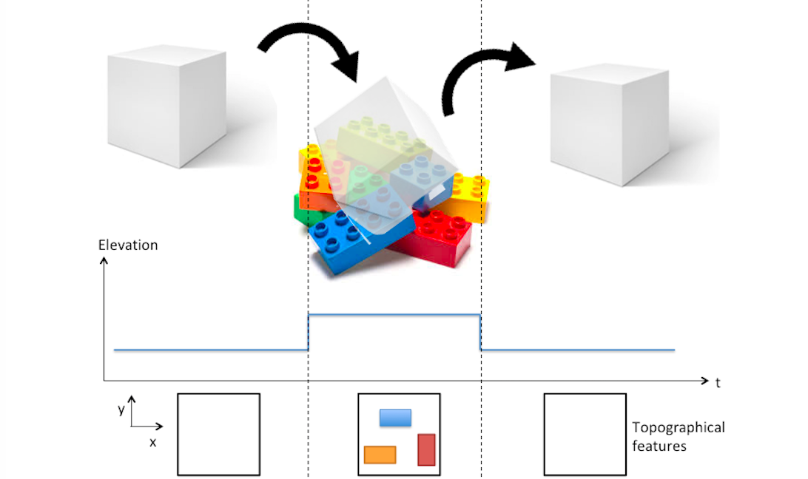
Problem Statement
A cuboid with a dynamic contact surface for adaptable motion and topographic mapping on variable terrains.

Slide 3



Deliverables
10/12
Order initial testing components
CAD model and design
Electronic architecture diagram
Complete solenoid testing
11/2
Prototype I constructed
Sensor calibration
Testing plan
12/3
Final cube finished
Achieve topographical mapping
Locomote over obstacle course

Slide 4
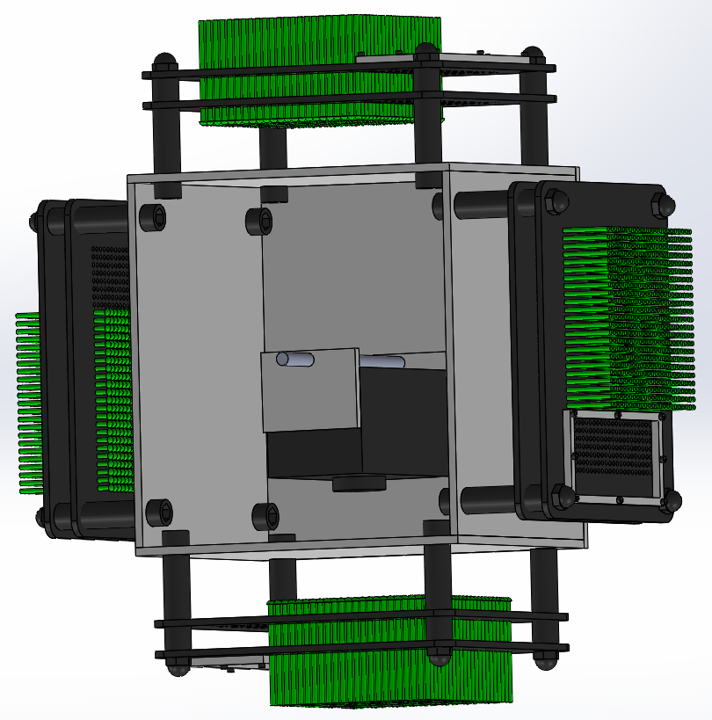
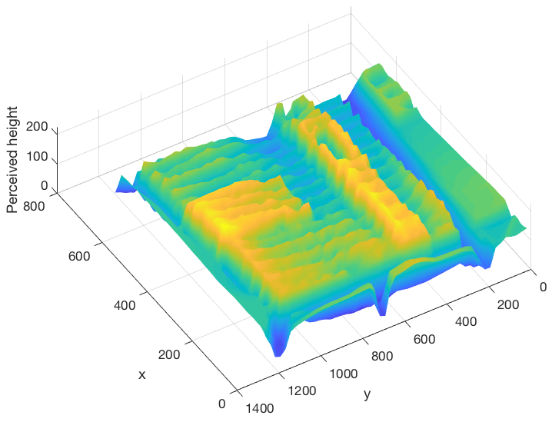
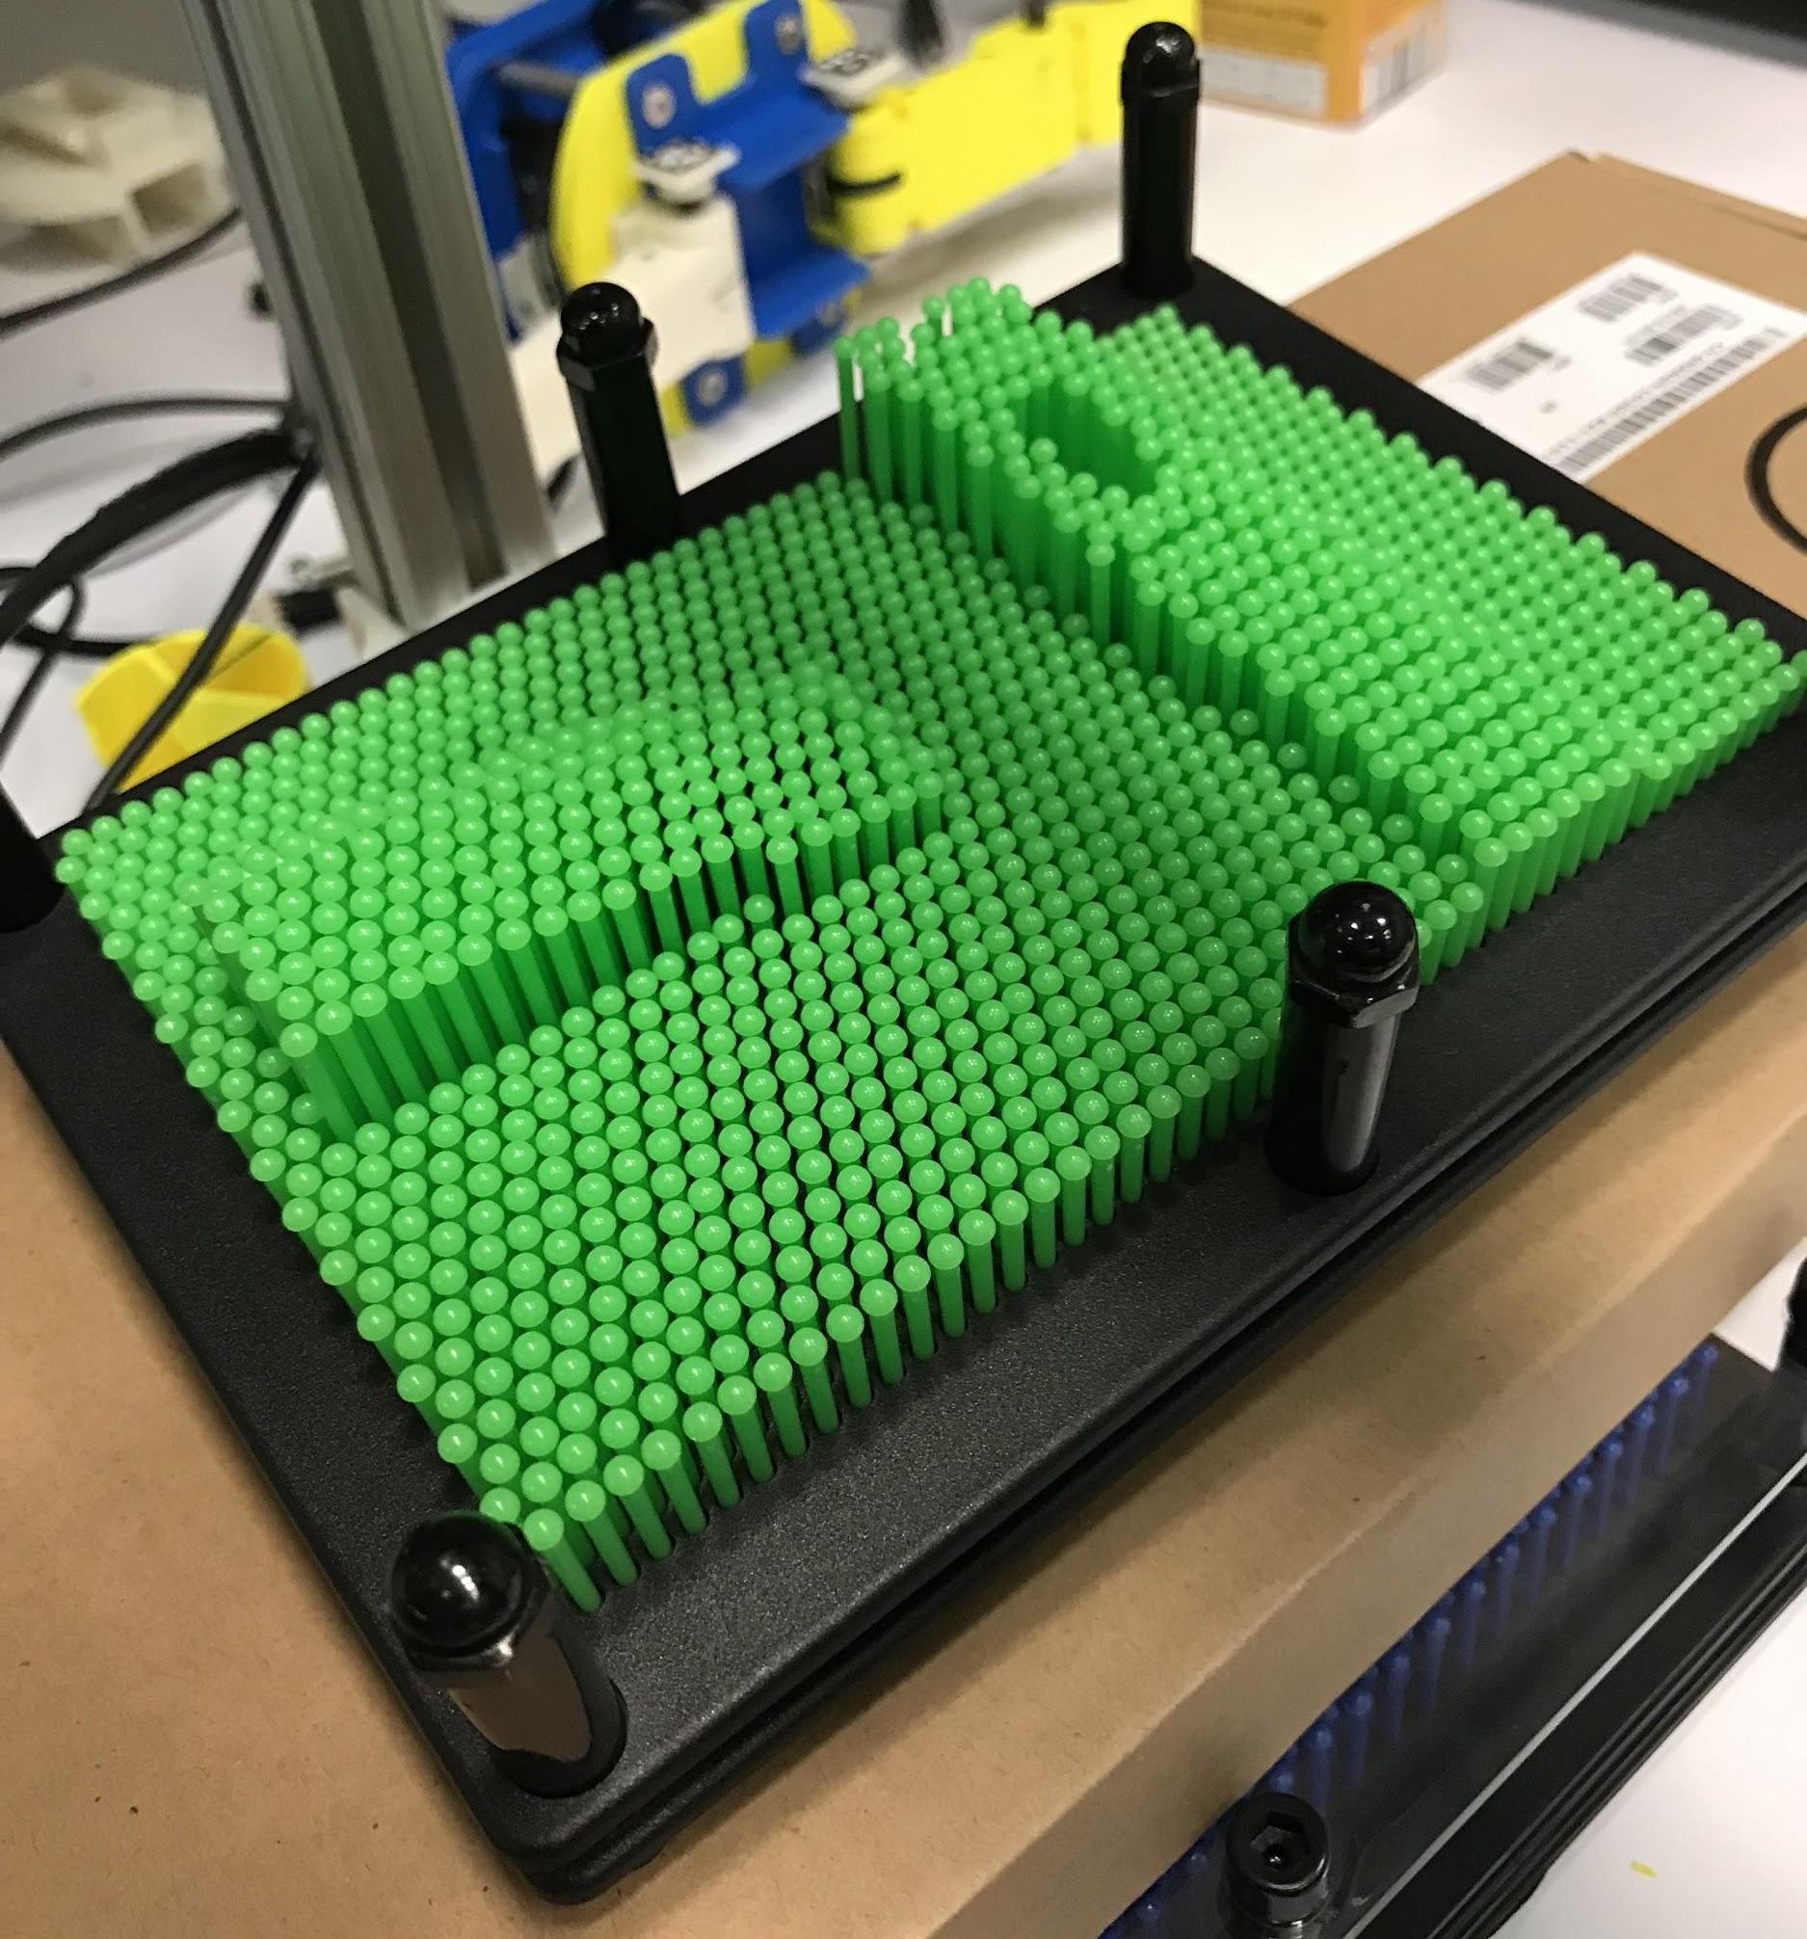
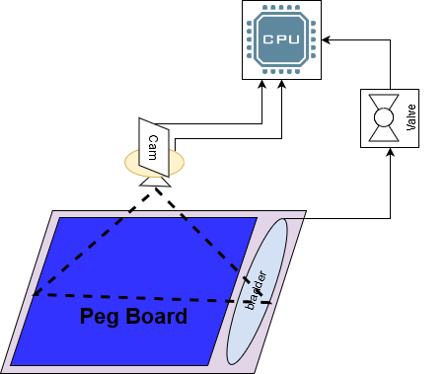
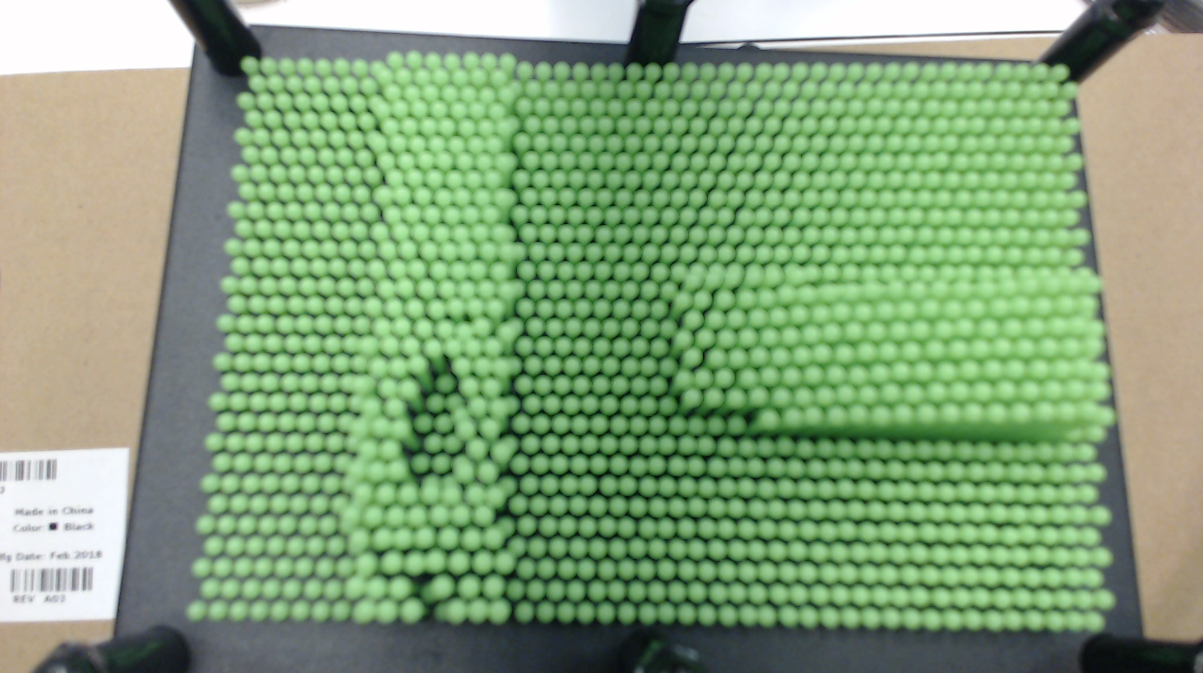
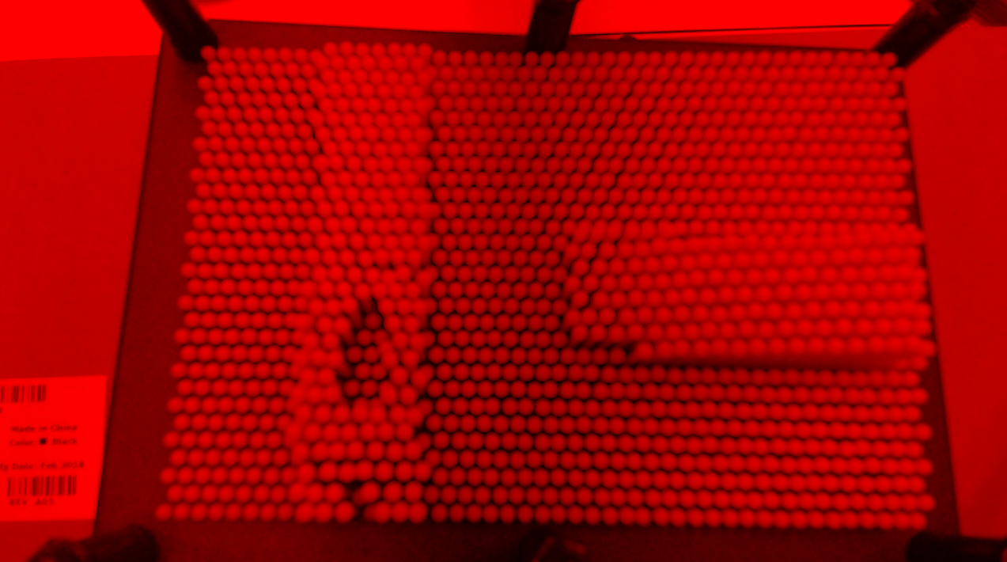

What we did
CAD of interior cuboid design
Initial image capture approach and processing alg
Electronic architecture sketch
Open side for viewing purposes
Rough electronic schematic
Discerned elevation map
Ground truth
raw
Filtered
Discretized
Custom pressure regulator

Slide 5


Problems
Solenoids are ineffective
Not enough force
Not enough travel
Solution: use pneumatic actuators to propel cube, pin art toy as mapping method
Lighting inconsistencies relation to recognition
Left: overhead light. Right: overhead and isometric light

Slide 6
Next Week
Laser cut v1 cube chassis out of light-weight acrylic
Begin to optimize recognition algorithm with testing of different LED configs and colors
Cast a silicone pneumatic bladder (easy)

